Slide 1
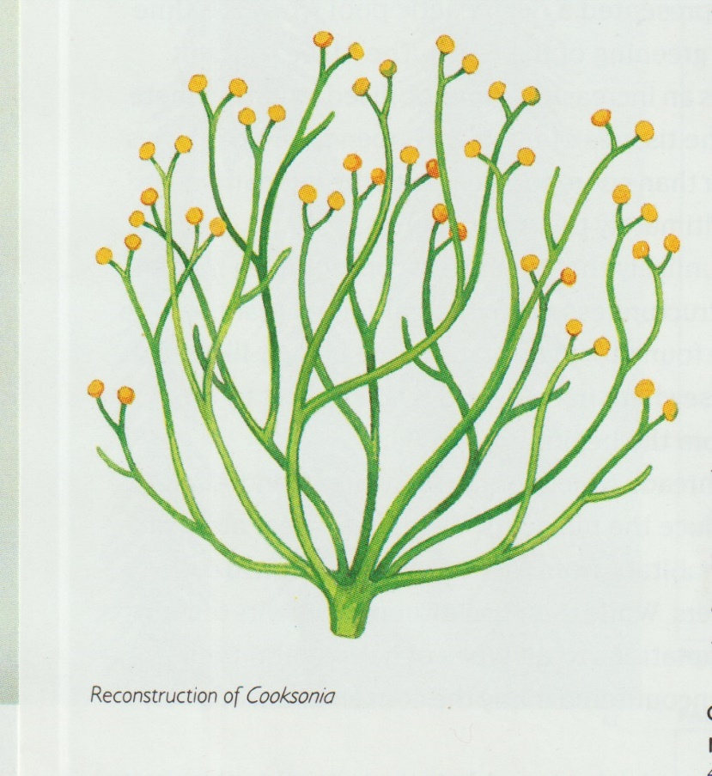
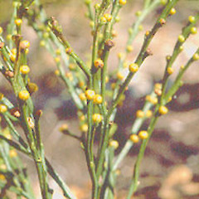
A little bit of palaeo-botany and other interesting botanical facts
Ancient ?
or
Modern?

Slide 2
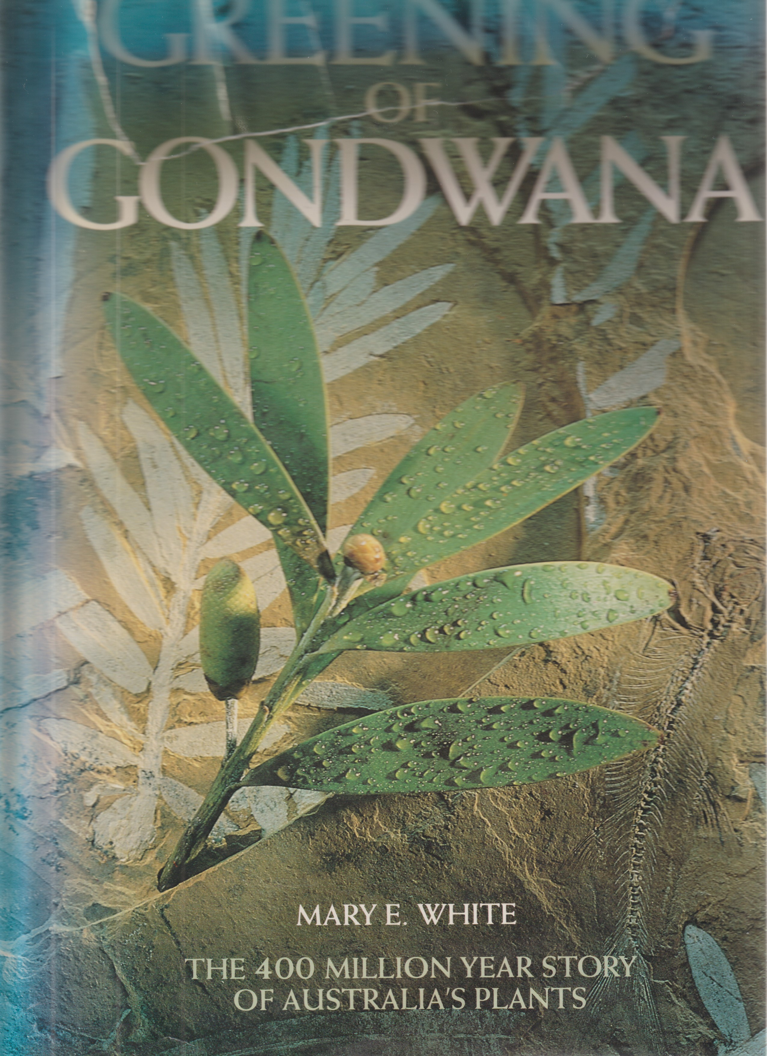
Mary White was born in Zimbabwe and attended the University of Cape Town, where she met her husband, a geologist. They later moved to Australia, a country with some of the oldest fossil flora in the world. In 1986 she wrote The Greening of Gondwana, which combines her interests in botany and geology, and illustrates how this flora has changed through time.

Slide 3
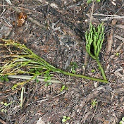
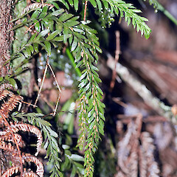
So little change in 400 million years. Psilotum nudum (left & centre) & Tmesipteris spp. are primitive ancestors to our ferns. They are rootless, the rhizomes having a symbiotic relationship with a fungus which enables the plants to live in quite arid environments.

Slide 4
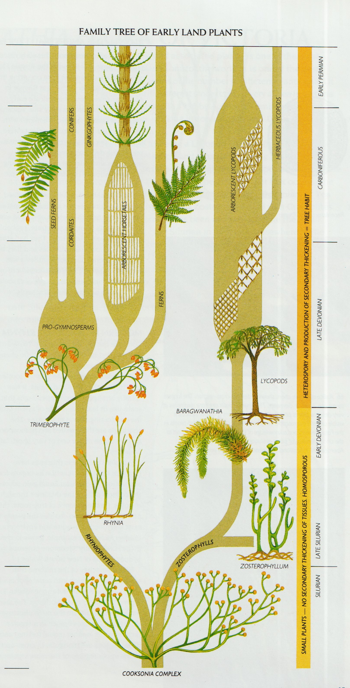
The right-hand branch of this early family tree of land plants shows how ancient the Lycopods, or clubmosses are. The left-hand branch eventually led to ferns, conifers and ginkgos. It was many hundreds of thousands of years before flowering plants put in an appearance.

Slide 5
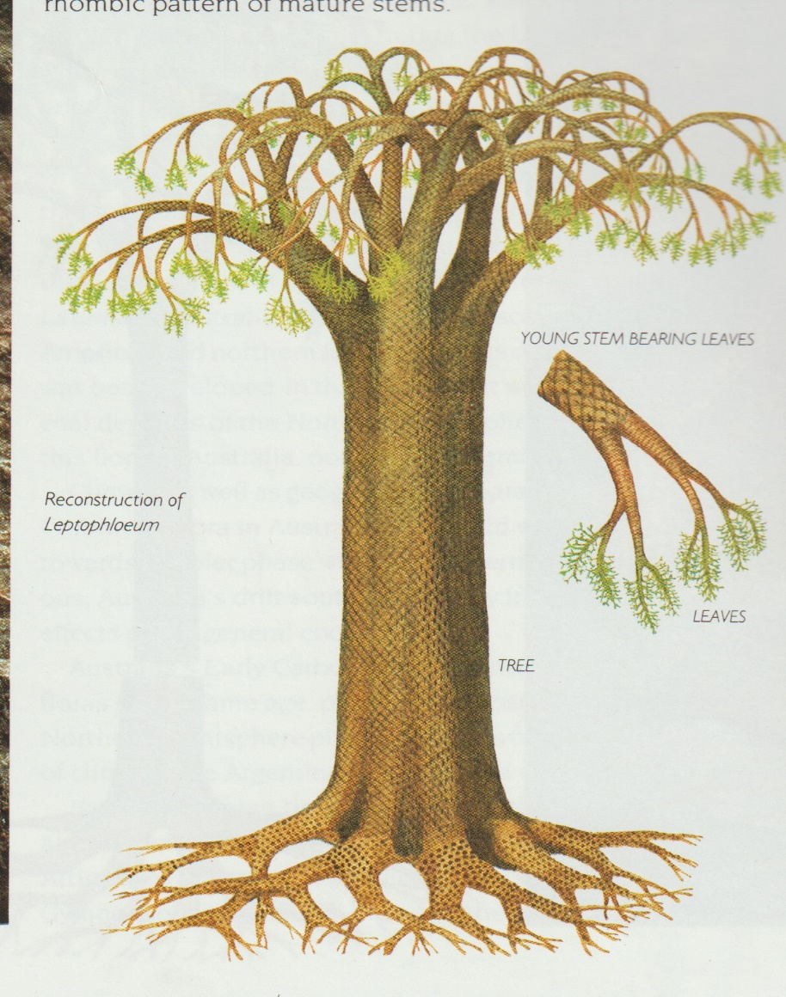
The early giant clubmoss flora contained tree-like plants with an unbranched trunk which forked repeatedly into a crown. They had cones which contained spores. In the northern hemisphere they grew in equatorial swamps and formed huge coal measures

Slide 6
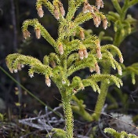
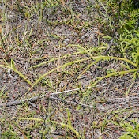
Now we only have herbaceous lycopods. Lycopodiella cernua has pendulous cones which shed thousands of minute spores when ripe. The horizontal stems loop across the ground – a handy device for climbing steep banks.

Slide 7
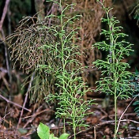
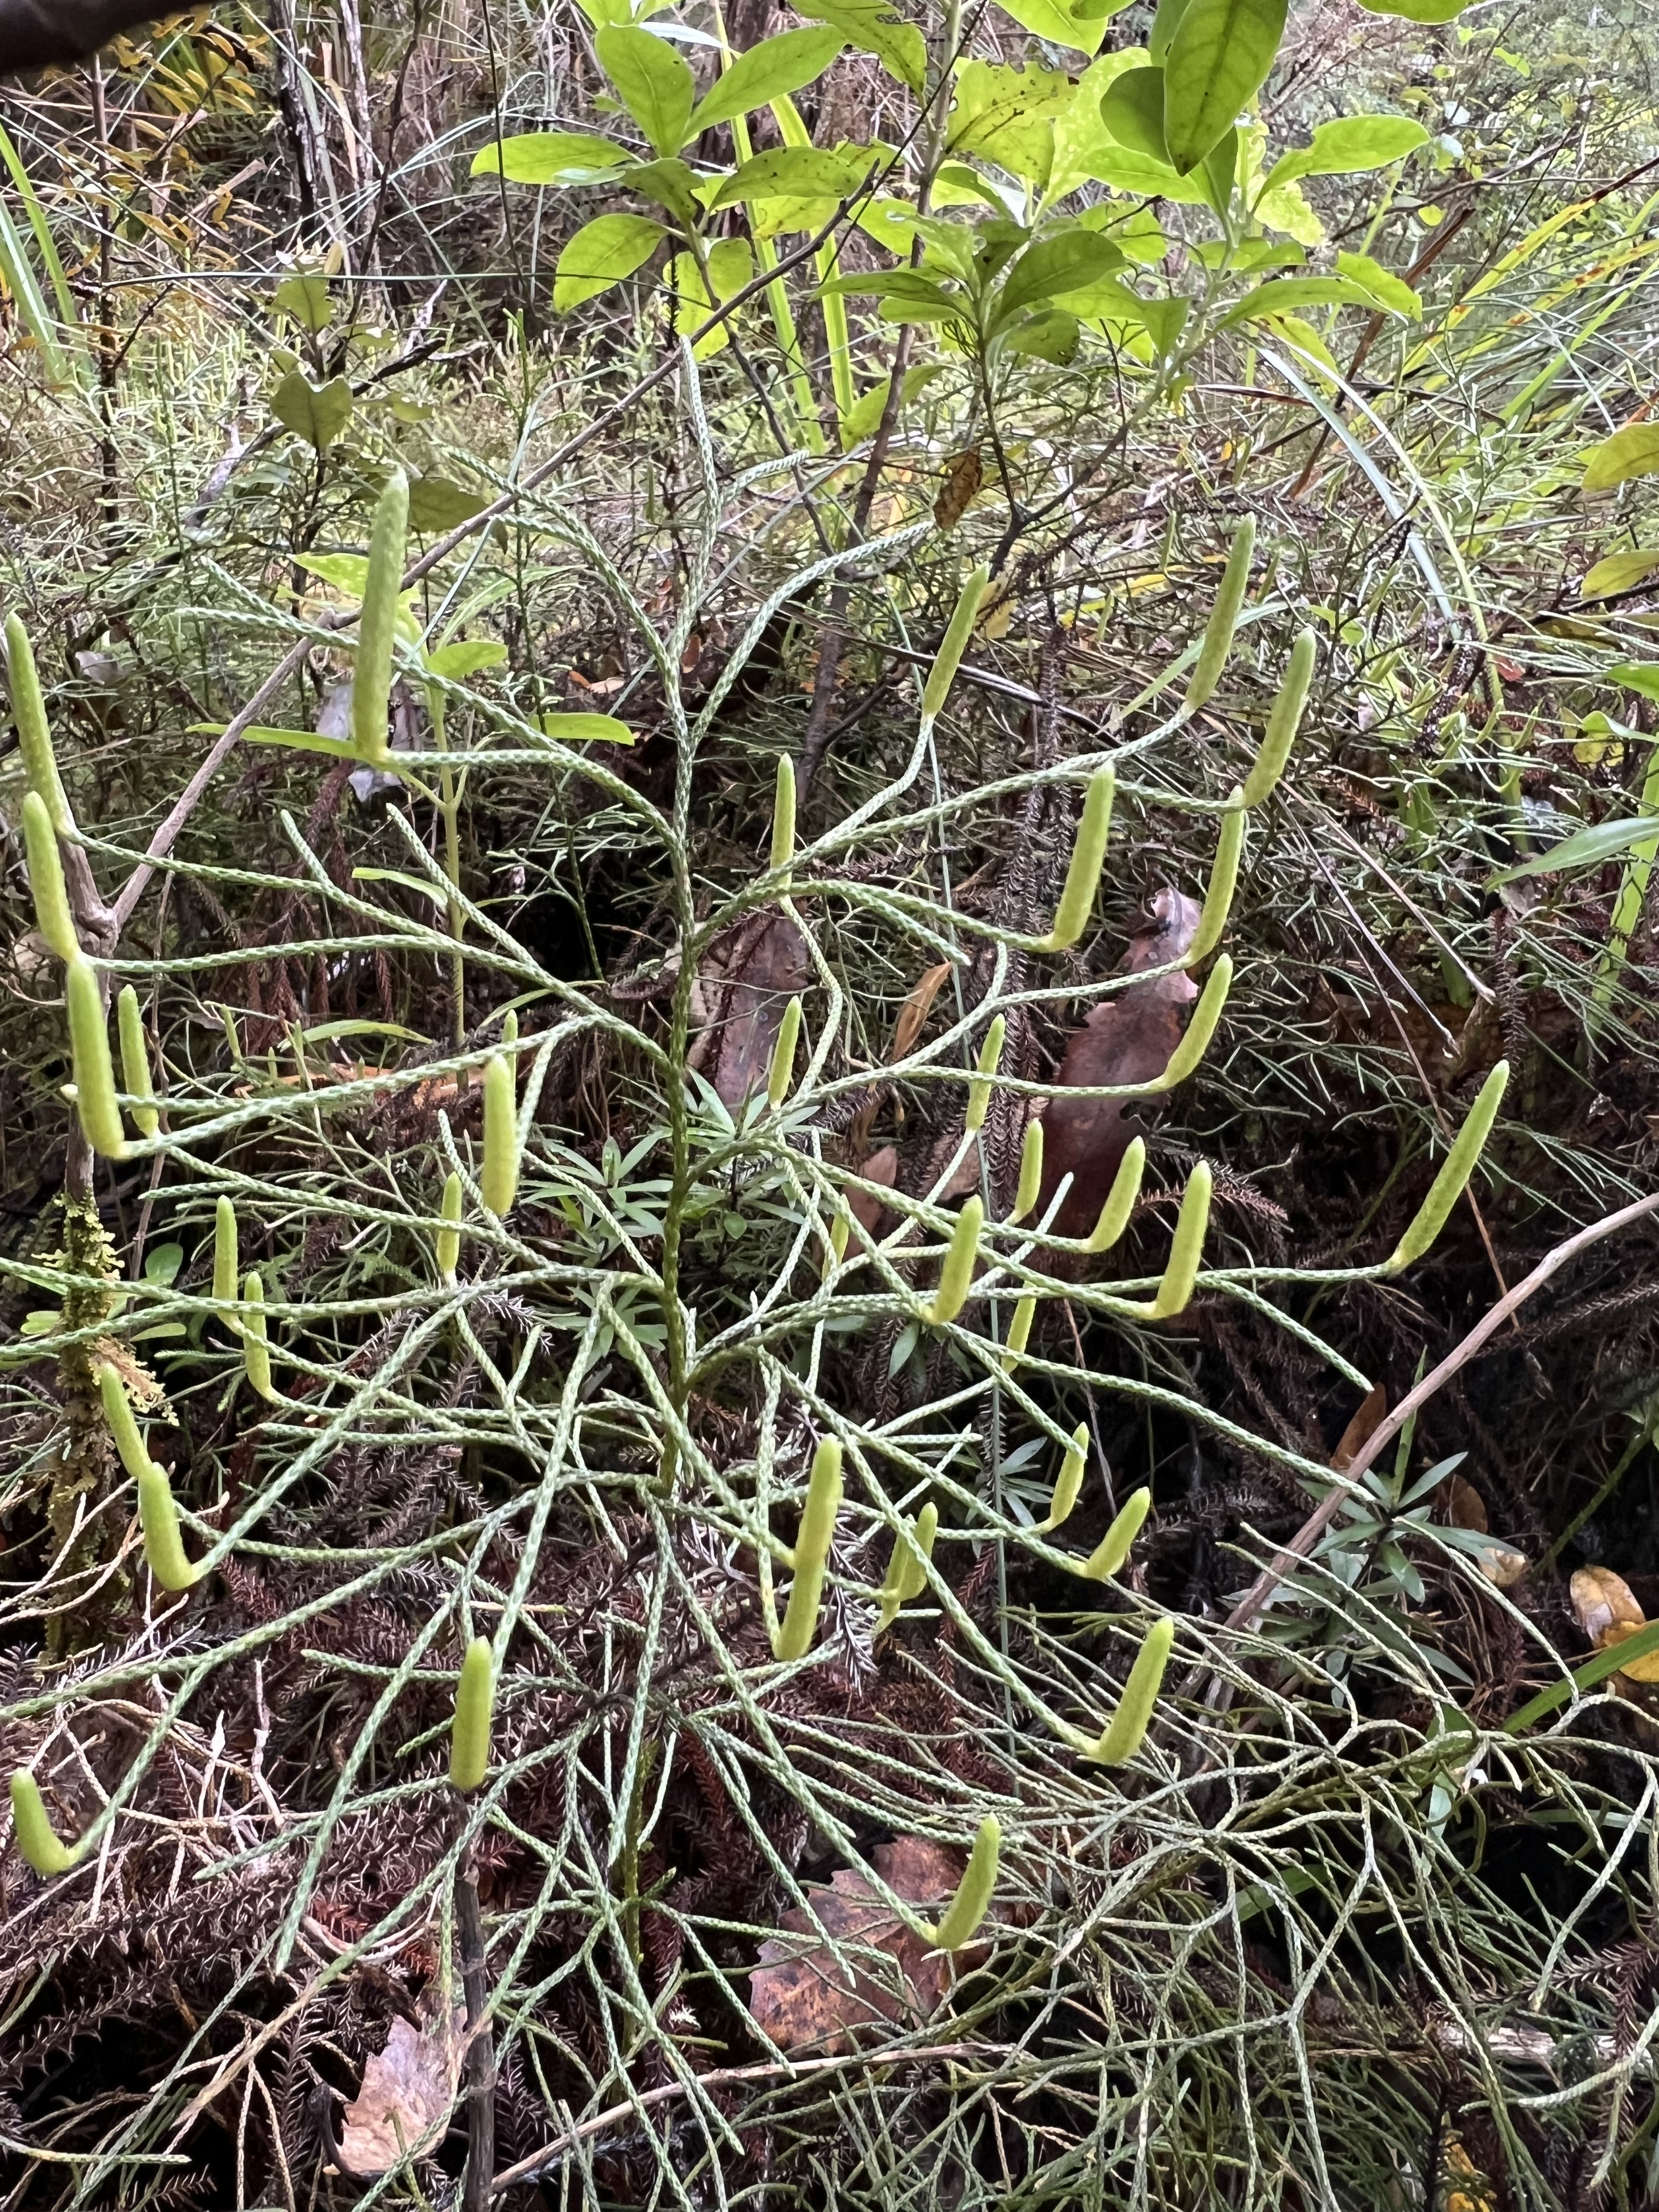
Lycopodium deuterodensum grows upright on stems that contain silica. A bunch of those stems, tied with a string of flax or cabbage tree, made a pioneer’s pot scrubber. Good for cleaning a porridge pot, one can imagine. The cones stand upright, like candles in a candelabra.

Slide 8
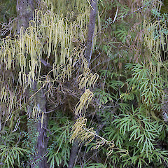
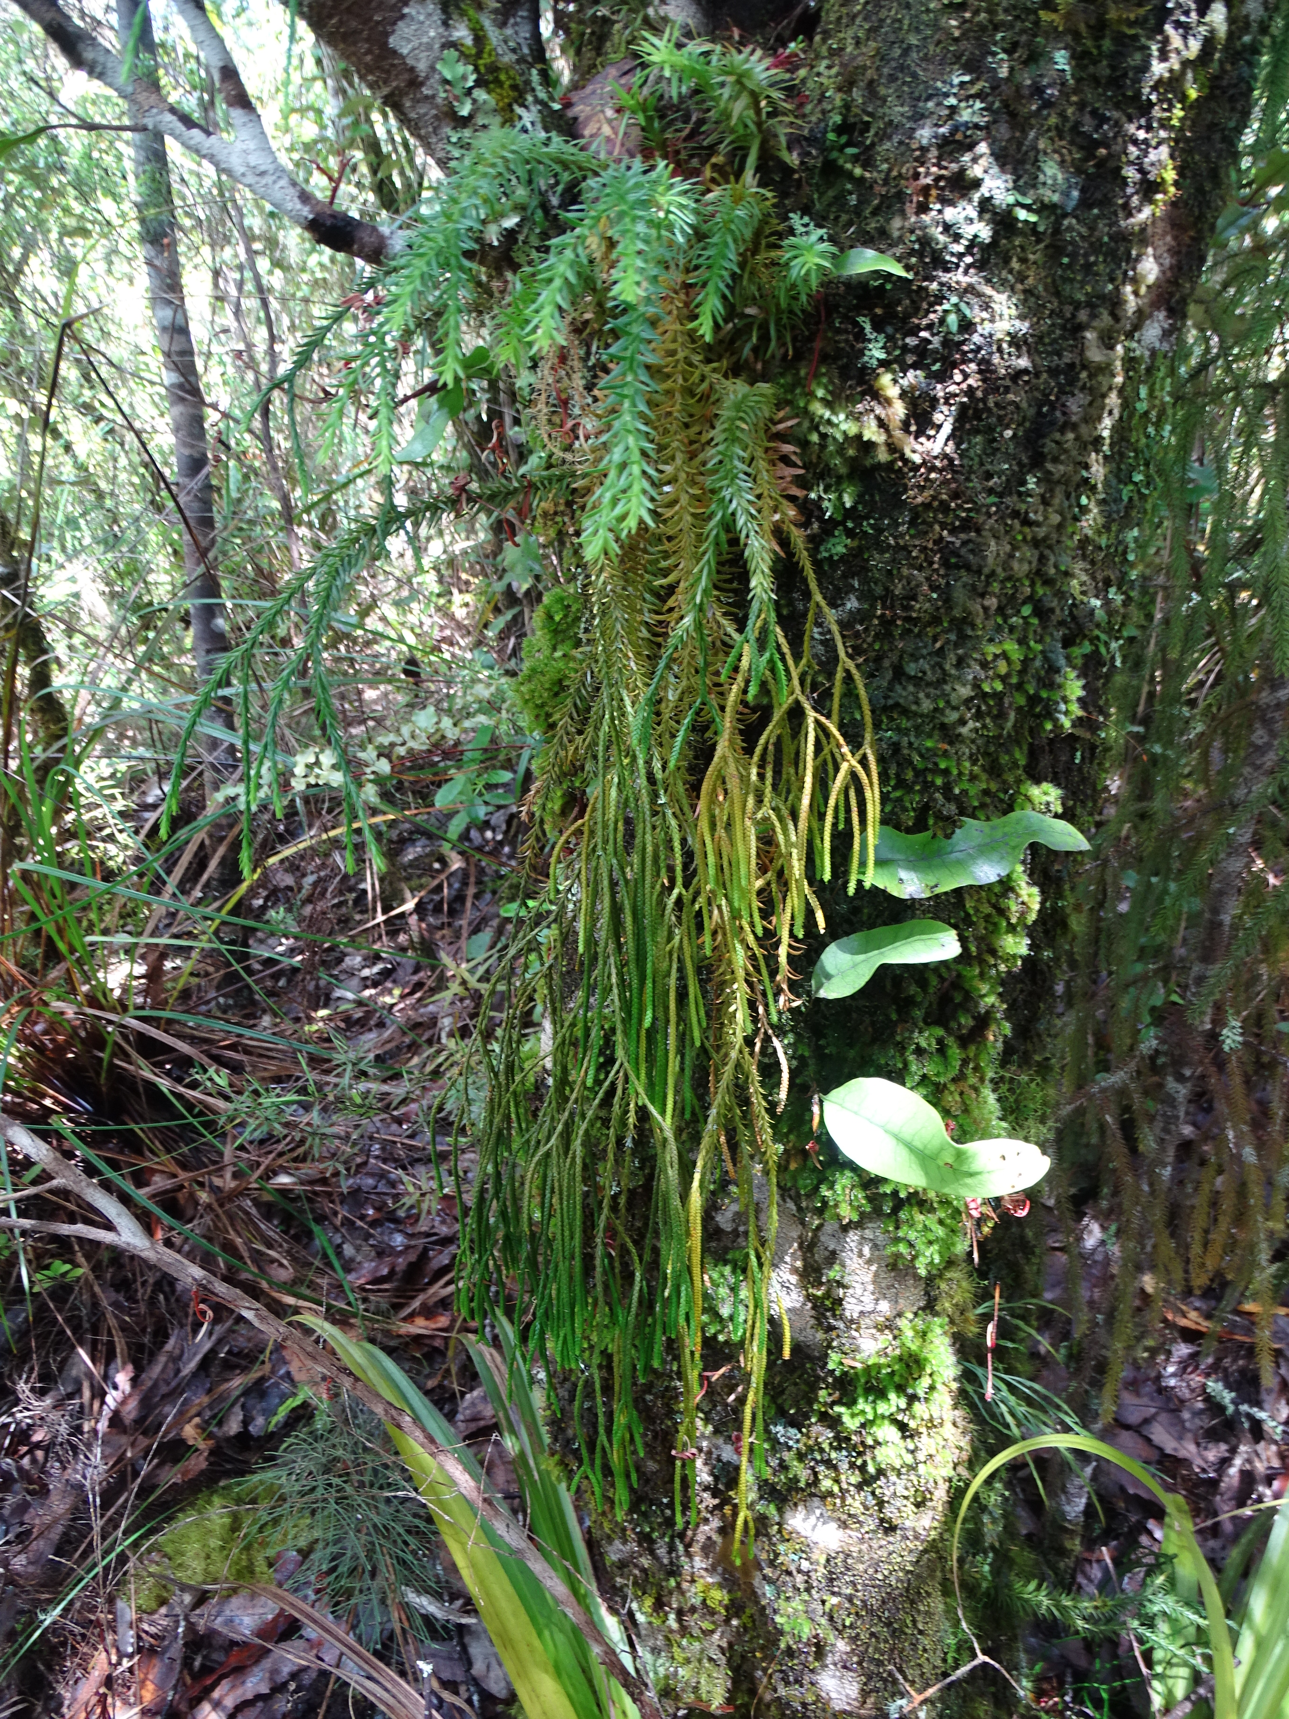
Lycopodium volubile is a scrambling plant often seen growing on clay roadside banks. The sterile branches have flattened leaves, the fertile branches have pendulous cones. Phlegmariurus billardierei is also a lycophyte.

Slide 9
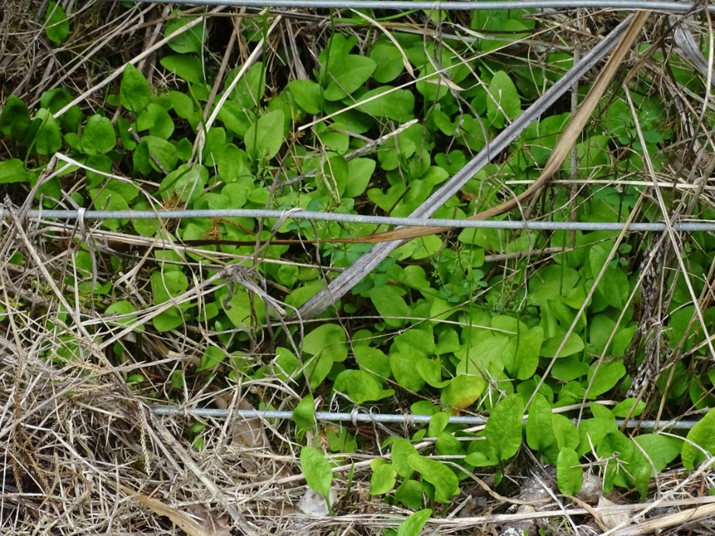
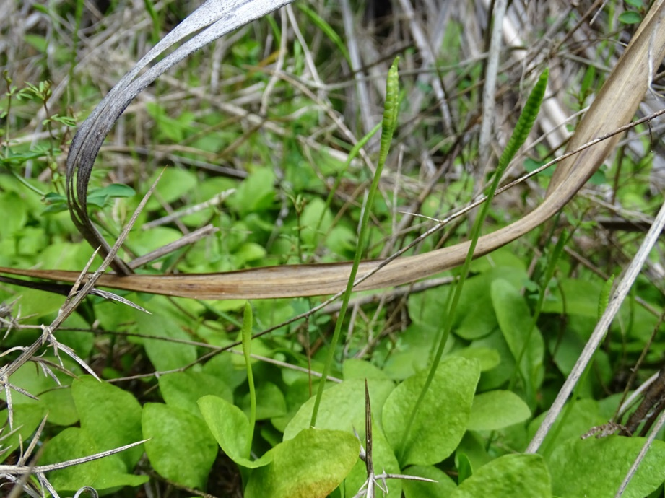
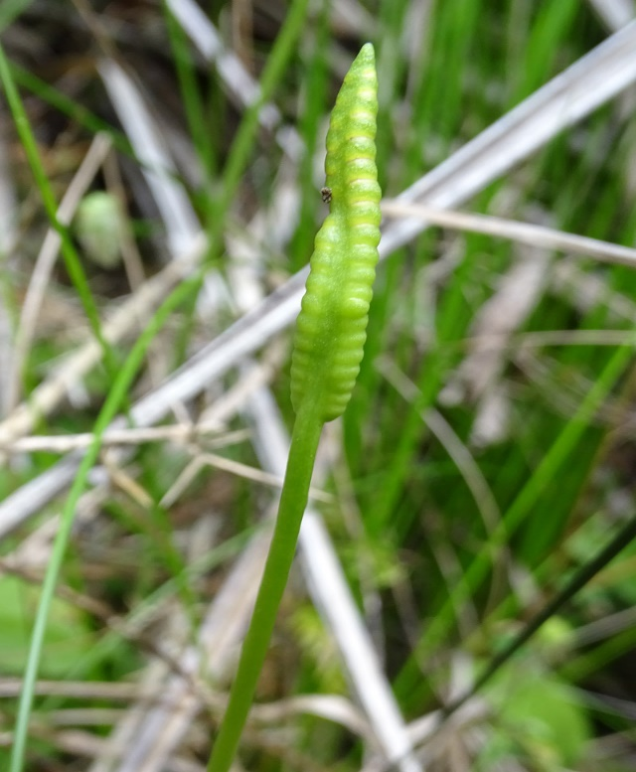
The Ophioglossaceae is one of the most primitive of our fern families. Ophioglossum (adder’s tongue) petiolatum, with a threat category of Nationally critical, is a summer-green fern. It can be seen growing on the roadside at Omaha.

Slide 10
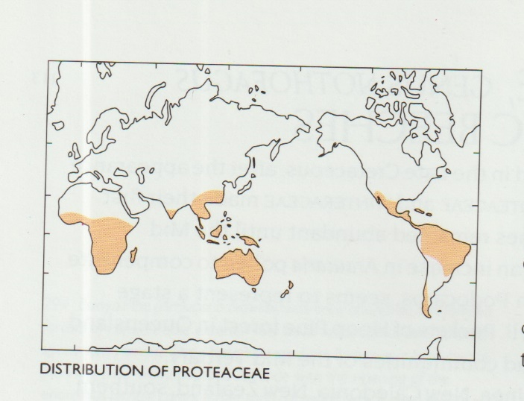
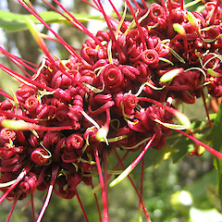
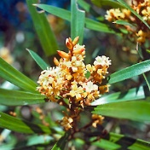
90% of the world’s plants are flowering plants. They put in an appearance c. 140 m.y.a., but didn’t diversify until c. 66 m.y.a. The Cretaceous was bad for dinosaurs but good for flowering plants. One of the earliest flowering families was the Proteaceae. In NZ we only have two extant plants in this family – Knightia excelsa (rewarewa) and Toronia toru (toru).

Slide 11
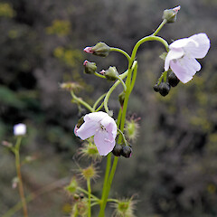
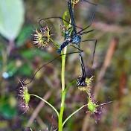
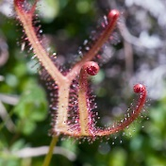
Drosera is the genus for sundews, some of our carnivorous flowering plants. D. auriculata (left & centre); note the smooth sepals,
& D. binata (right).

Slide 12
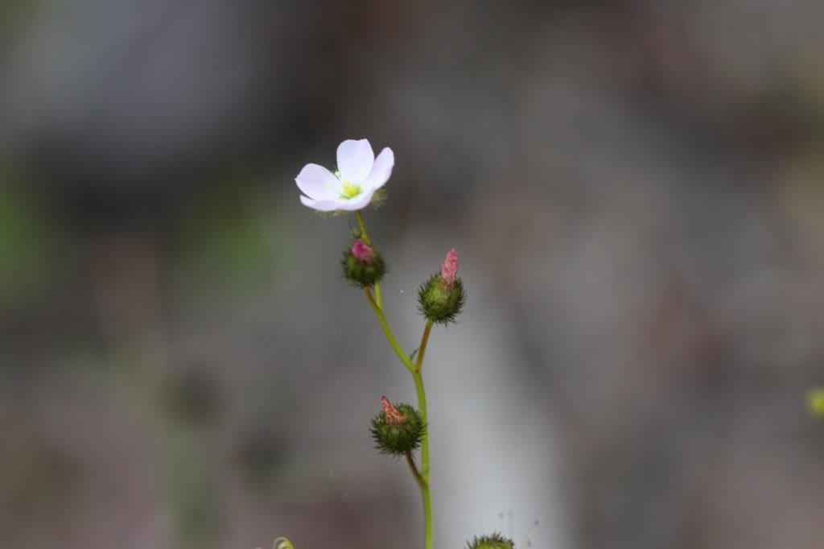
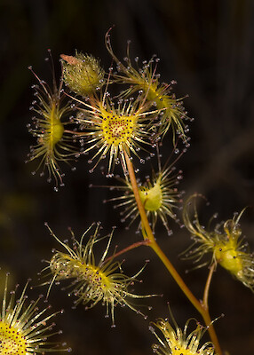
Drosera gunniana was first described in New Zealand in 2001 in the Far North; it is also found in Australia. It has gradually moved south as far as the Waikato. It is found in scrubland at Mataia. Compare the golden hairs on the sepals with the smooth sepals on D. auriculata.

Slide 13
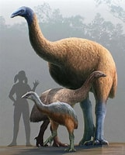
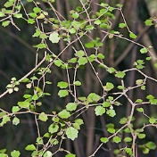
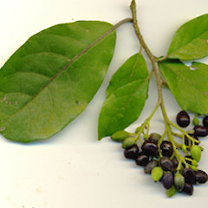
“The moa browse theory” – true or not?
Moa evolved and co-existed with the plants of NZ for tens of millions of years. To some it seems logical that the plants should have adapted to resist moa grazing. Others are convinced that this is not so. The moa gizzard was like a second stomach, and the birds swallowed hard stones, or gizzard stones, to help grind twigs & small branches.

Slide 14
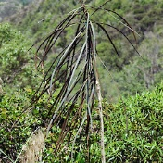
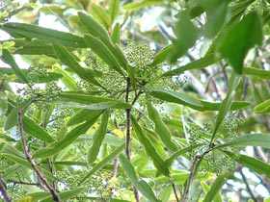
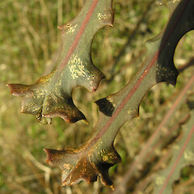
Pseudopanax crassifolius (lancewood) has distinctive juvenile leaves, but once above the height of moa, the leaves change. P. ferox doesn’t grow locally, but is easily distinguished by the hooked lobes crowded at the leaf base of juvenile leaves. Moa never made it to the Chatham Islands, and the lancewoods there don’t have juvenile leaves.

Slide 15
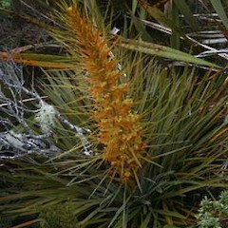
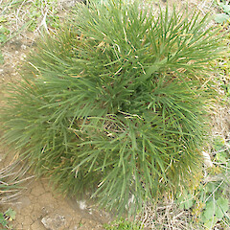
Aciphylla spp. (wild Spaniards), such as A. colensoi (left), are in the carrot family and are therefore very palatable. A moa trying to eat one would put its eyes in danger. A. dieffenbachii (right) growing on the Chatham Islands has soft leaves.

Slide 16
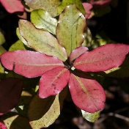
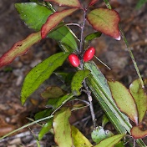
Mimicry is another postulated example of being a moa deterrent. The leaves of Pseudowintera colorata (horopita) on the left, have a foul taste, whereas the leaves of the similar-looking Alseuosmia pusilla on the right, do not.

Slide 17
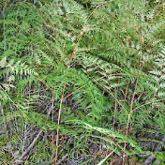
The rhizomes of bracken (Pteridium esculentum) were a staple of the pre-European Maori diet, and bush was often burnt to encourage its growth. All parts of the fern have proven to be toxic.

Slide 18
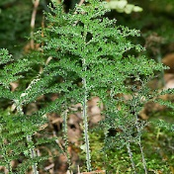
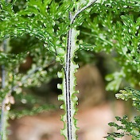
A little bit of frivolity!
Botanists sometimes have pet names for plants. For obvious reasons Hymenophyllum flexuosum has the nickname of “frilly knickers”. Usually found in rather damp gullies on rocks or roots of trees.

Slide 19
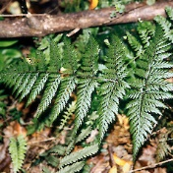
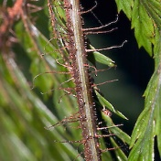
“Old hairy legs”. The stipes, or stems of Lastreopsis hispida are densely covered in dark bristle-like scales and hairs.

Slide 20
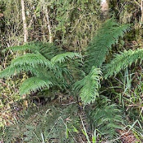
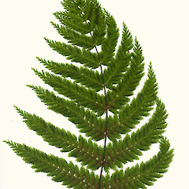
Leptopteris superba, or Prince of Wales feathers, grows in colder parts of the country. It’s “brother” (i.e. in the same genus), L. hymenophylloides, used to be fancifully called Prince Andrew. Who is the Prince of Wales’ brother now? Prince Harry?

Slide 21
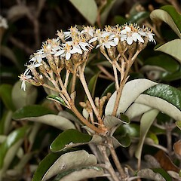
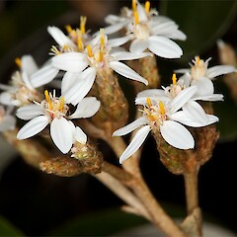
Olearia furfuracea grows mostly in soils lacking in fertility. Jokingly known as “Arkwright’s daisy.

Slide 22
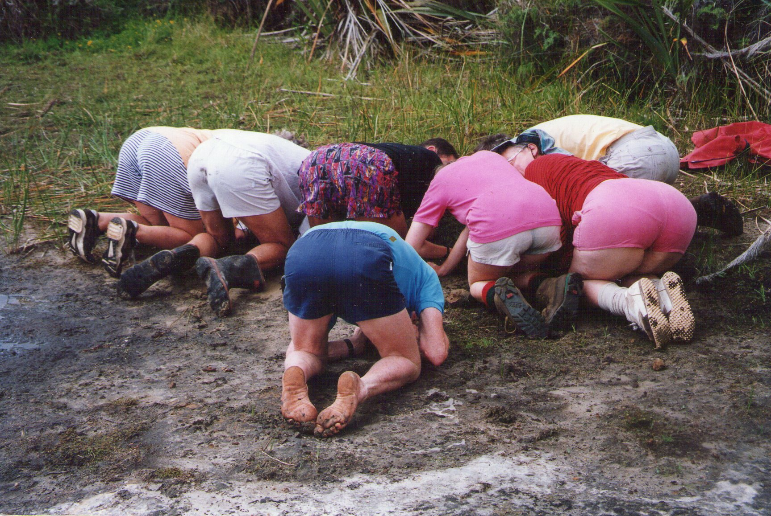
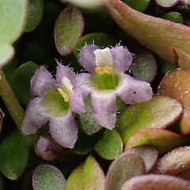
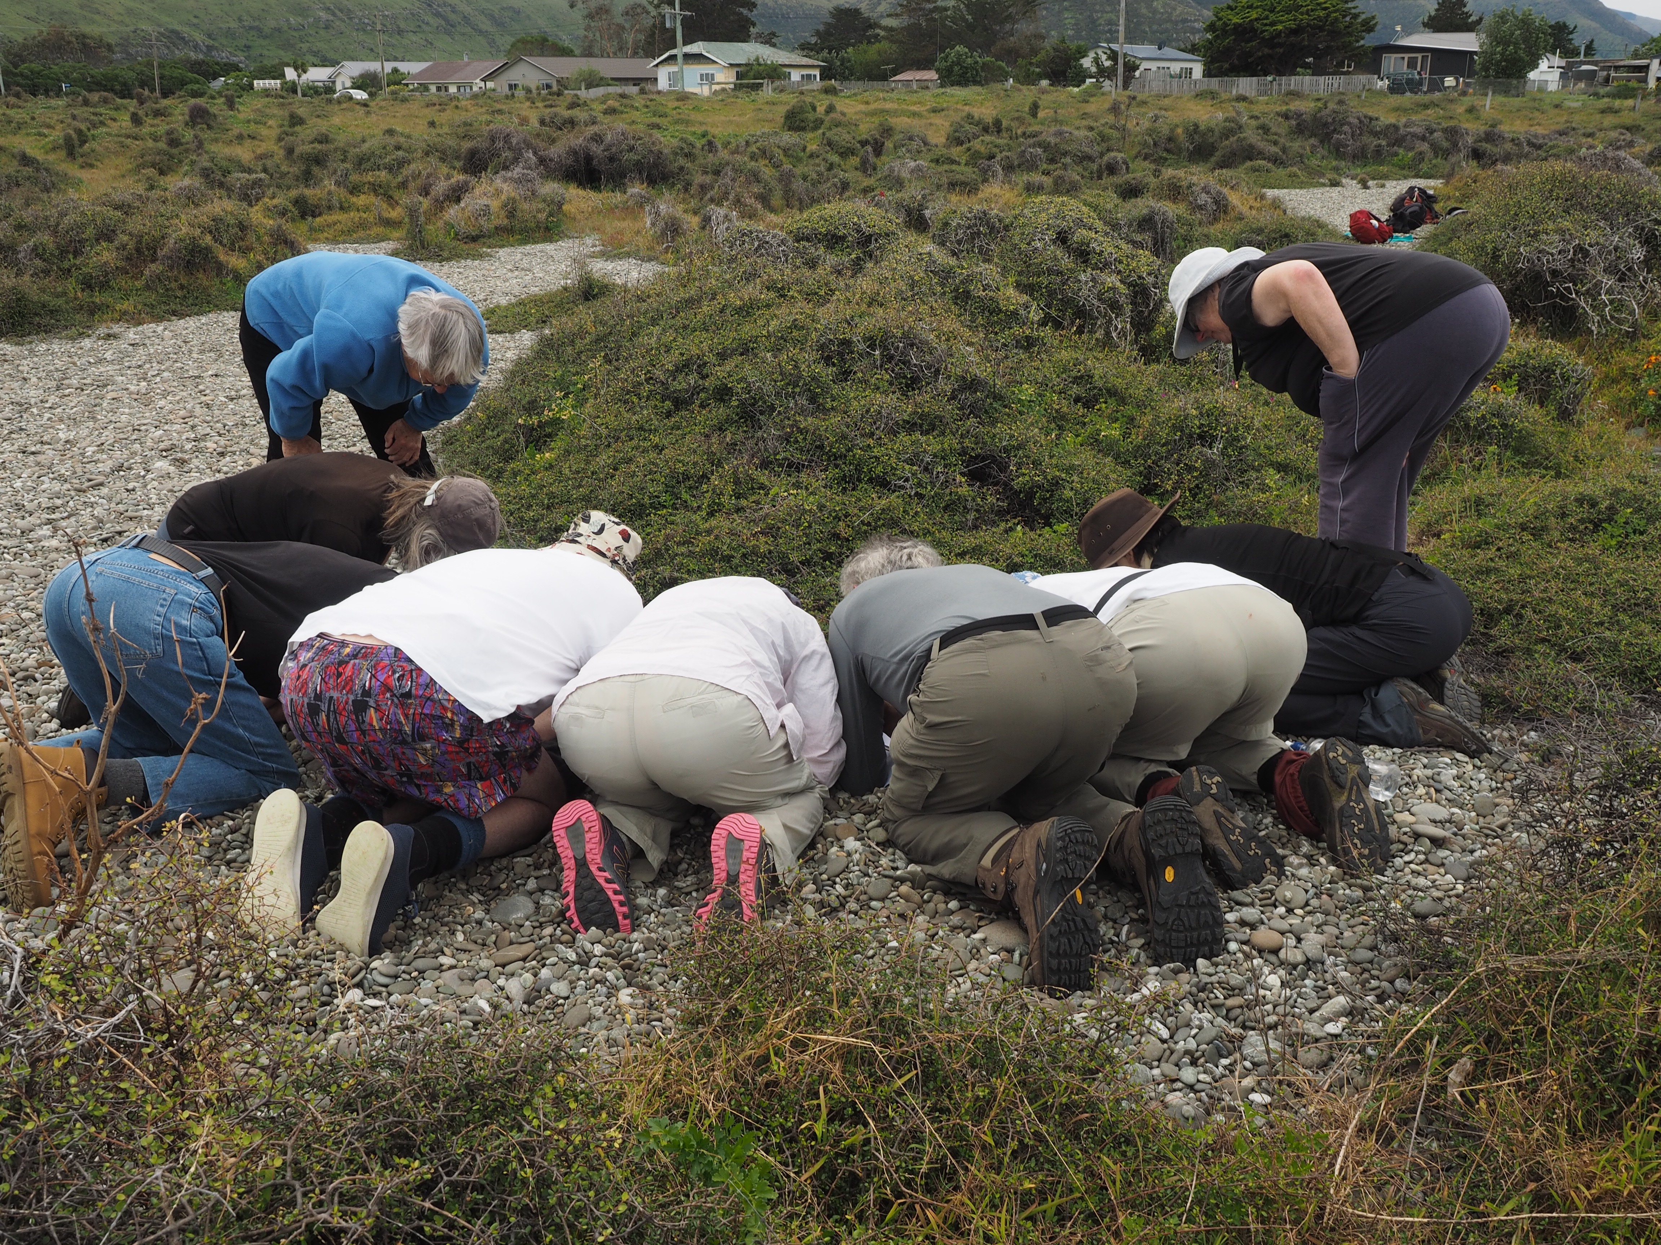
“Bot” Soc

Slide 23
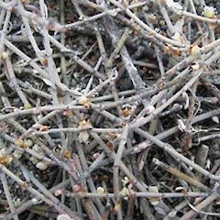
“Bot” Soc

Slide 24
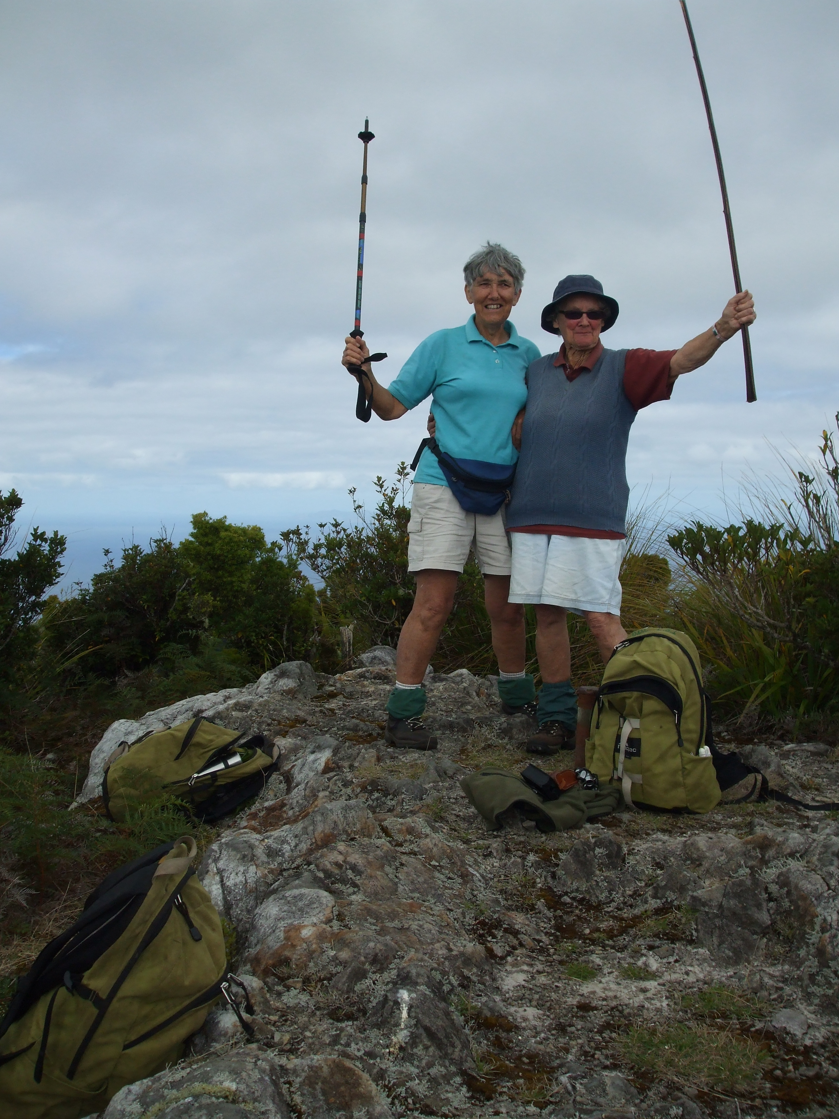
Adventure before dementia

